Slide 1

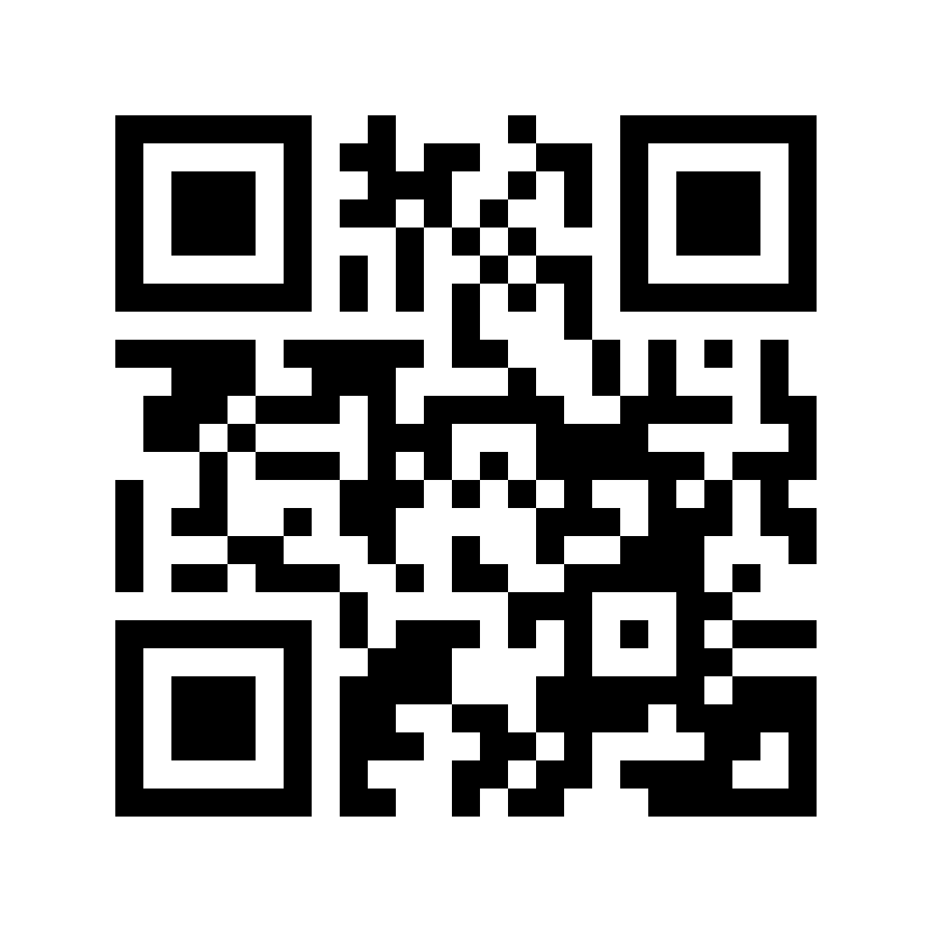
Learning outcomes:
End-to-end
data validation strategies
in Microsoft Fabric
To walk away with an understanding of:
why data quality should be at the heart of your Fabric data strategy
how to architect/ build enterprise-scale data validation systems in Fabric that give you confidence and build trust
Please leave feedback!
Notes:
The key learning outcomes for this course are that I want you to walk away with a solid understanding of what Fabric is, the problem(s) it solves and how it solves them.
But more than just the boring what, why and how of Fabric, REALLY what I want is to share some of my passion and excitement for Fabric with you,
[click]
so that you leave with an appreciation for the huge opportunity that Fabric represents for your organization and for you personally in your own career.

Slide 2
IN THIS TALK
Part 1: The case for data validation in Fabric
Part 2: Foundation
Part 3: Further considerations
The problem(s) that data validation solves
Architectures for data validation
Enterprise-scale monitoring
Why Fabric?
Strategies for data validation at 3 key stages
Failure handling strategies
Tools for data validation in Fabric
Tying into Data governance

Slide 3
A WIDE RANGE OF STRATEGIES FOR DATA VALIDATION
(AT A HIGH-LEVEL)
Aimed at strategists (architects, decision-makers)

Slide 4
BUT DEEP DOWN, I’M AN IMPLEMENTATION GUY
I love to build things

Slide 5
AND THE BEST STRATEGIES (I BELIEVE) ARE ROOTED IN REALITY
And reality comes from implementation

Slide 6



AND THE BEST STRATEGIES (I BELIEVE) ARE ROOTED IN REALITY
And reality comes from implementation
Slides
Slides
Slides
Implementation notebooks
+
Available (for free!):
.com/microsoft-fabric

Slide 7


WHO IS THIS GUY?
8+ years working as a data professional
Working across business intelligence, then data science, real-time analytics and then data engineering and data warehousing.
In January 2024, I quit my full-time consulting role to focus 100% on teaching Microsoft Fabric
@LearnMicrosoftFabric
Hi, I’m Will Needham
Full-time Fabric educator
.com/microsoft-fabric

Slide 8
LET’s BEGIN…

Slide 9



Why data validation is so important
Regulation might demand it
Poor decisions
Loss of revenue
Customer dissatisfaction
Loss of trust in your solution

Slide 10
Pipeline problem bingo:
what can go wrong at each stage in the pipeline?
Get new data from a source
Perform some cleaning
Enrich the data (joins, creating dimensions)
Build analytics models (calculation, aggregations)
Build semantic model
Connection details change
Schema changes (changes to datatypes, column names etc)
Data not returned
API/ server error
Null values in important columns
Values outside expected ranges
Date formats/ data types in
Values outside pre-defined lists
Referential integrity violations
Incorrect join logic
Duplicate primary keys
Incorrect business logic
Incorrect aggregation granularity
Handling of nulls
Incorrect relationships
Wrong business logic
DAX measures not returning correct values

Slide 11
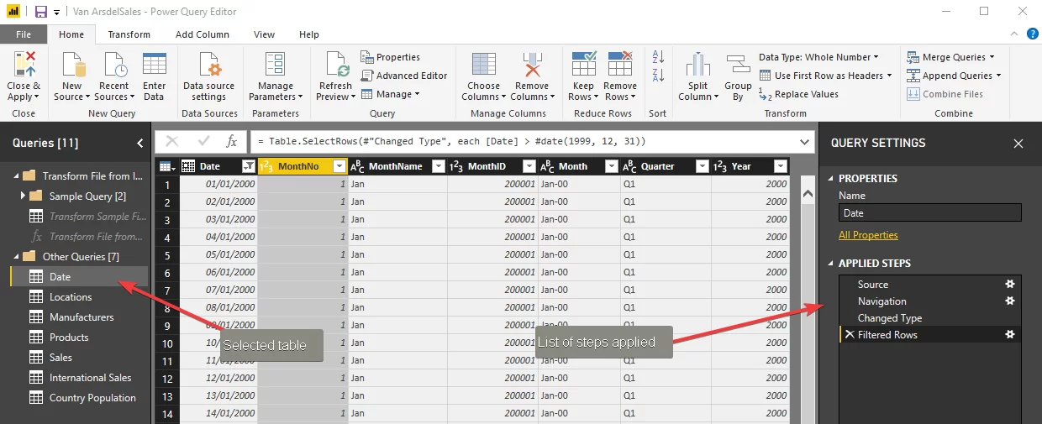
Implementing this pipeline (old-skool Power BI)
Get new data from a source
Perform some cleaning
Enrich the data (joins, creating dimensions)
Build analytics models (calculation, aggregations)
Build semantic model
Notes:
In a traditional Power-BI centric workflow, these steps all take place within PowerQuery and DAX.
The problem with this is that if any of the problems occur, it’s difficult to detect, because we’re doing all of our transformation steps in one place.
There will be two types of error occur:
Refresh failure - your Power BI model will not refresh. Not great, but better than the second error type:
Refresh successful, but with data quality issues introduced to the semantic model.

Slide 12

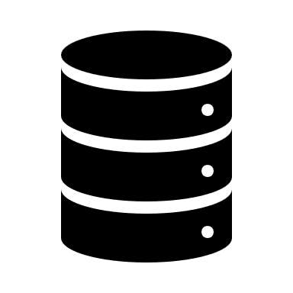



What could this look like in Fabric?
Get new data from a source
Parsing/ cleaning
Enrich the data (joins, creating dimensions)
Build analytics models (calculation, aggregations)
Build semantic model
Validate and write
Validate and write
Validate and write
Validate and write
Validate
Lakehouse files
Lakehouse files
Lakehouse table
Lakehouse table
Warehouse table
Semantic model
Notes:
Enter Fabric. Instead of having to do all the transformations in Power BI/ Power Query, now we can space these steps out. So at each of the steps above, we can write out the intermediary data to a data store, like a lakehouse table.
This architectural pattern is commonly referred to as the medallion architecture.
There are many benefits in doing this. But for the purposes of this I want to focus on one benefit in particular: with this approach you can validate the data at each of these steps.
In doing so, we progressively assure the quality of data at different stages in our pipeline.

Slide 13
What could this look like in Fabric?
Data Quality Checkpoint
Data Quality Checkpoint
Data Quality Checkpoint
Data Quality Checkpoint
Data Quality Checkpoint
Get new data from a source
Parsing/ cleaning
Enrich the data (joins, creating dimensions)
Build analytics models (calculation, aggregations)
Build semantic model
Validate and write
Validate and write
Validate and write
Validate and write
Validate
Lakehouse files
Lakehouse files
Lakehouse table
Lakehouse table
Warehouse table
Semantic model

Slide 14

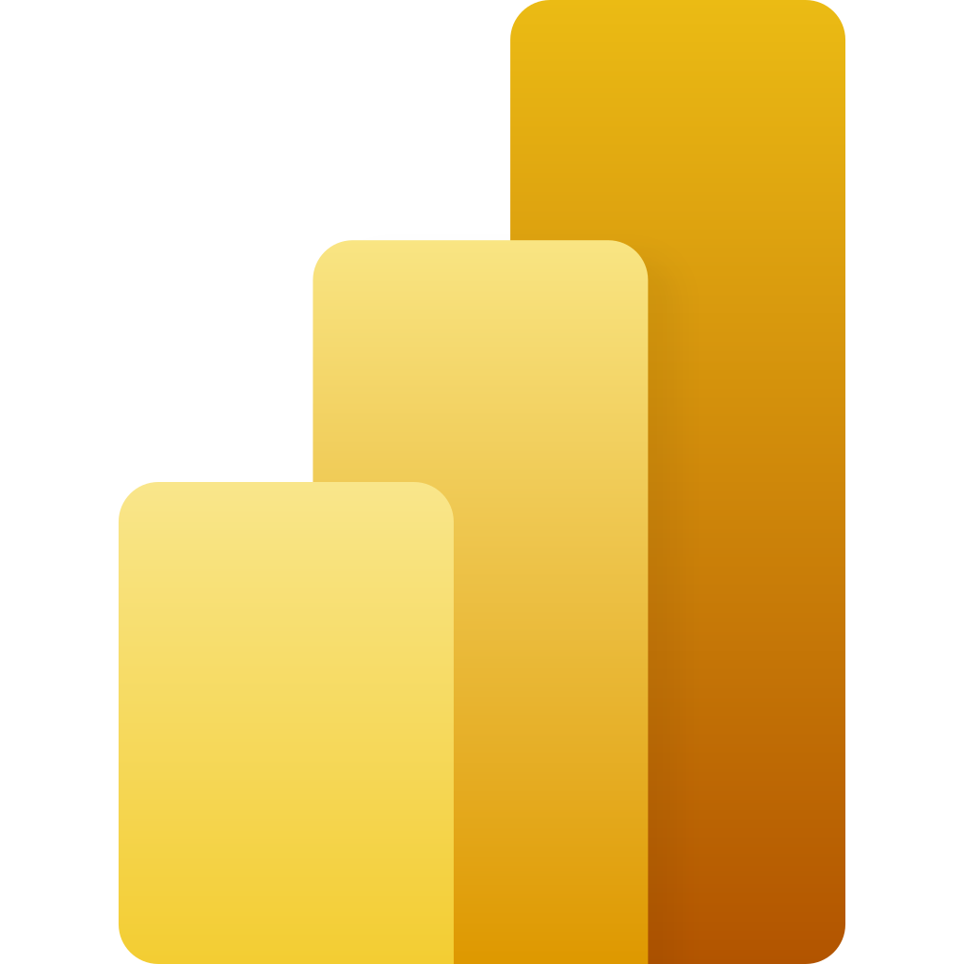

What could this look like in Fabric?
Progressive assurance of
data quality
Data Quality Checkpoint
Data Quality Checkpoint
Data Quality Checkpoint
Data Quality Checkpoint
Data Quality Checkpoint
User’s eyes
Source system/ files
Lakehouse files
Lakehouse files
Lakehouse table
Lakehouse table
Warehouse table
Semantic model

Slide 15
What could this look like in Fabric?
Get new data from a source
Parsing/ cleaning
Enrich the data (joins, creating dimensions)
Build analytics models (calculation, aggregations)
Build semantic model
1
2
2
2
Validate and write
Validate and write
Validate and write
Validate and write
3
Validate
Lakehouse files
Lakehouse files
Lakehouse table
Lakehouse table
Warehouse table
Semantic model
1
Schema validation of incoming files/ Python objects
2
Table/ data frame validation
3
Semantic model validation

Slide 16
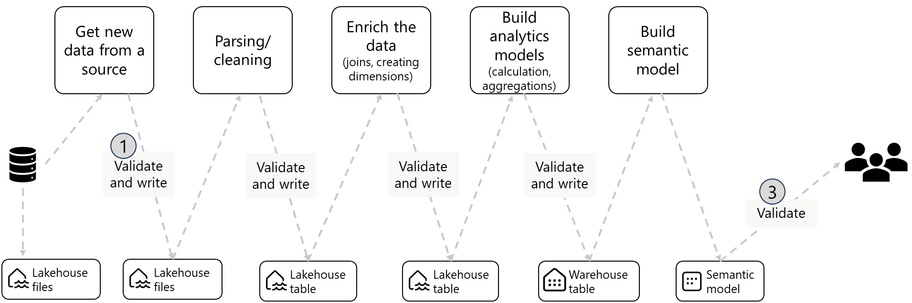
1
Schema validation of incoming files/ Python objects
Core purpose:
Validation that incoming data conforms to an expected schema.

Slide 17
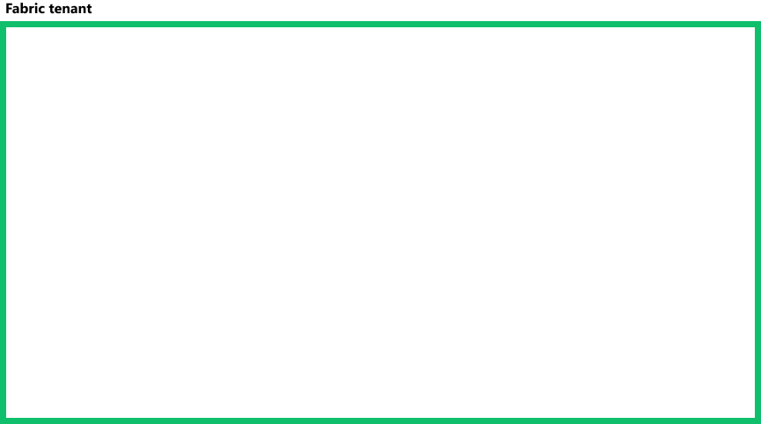

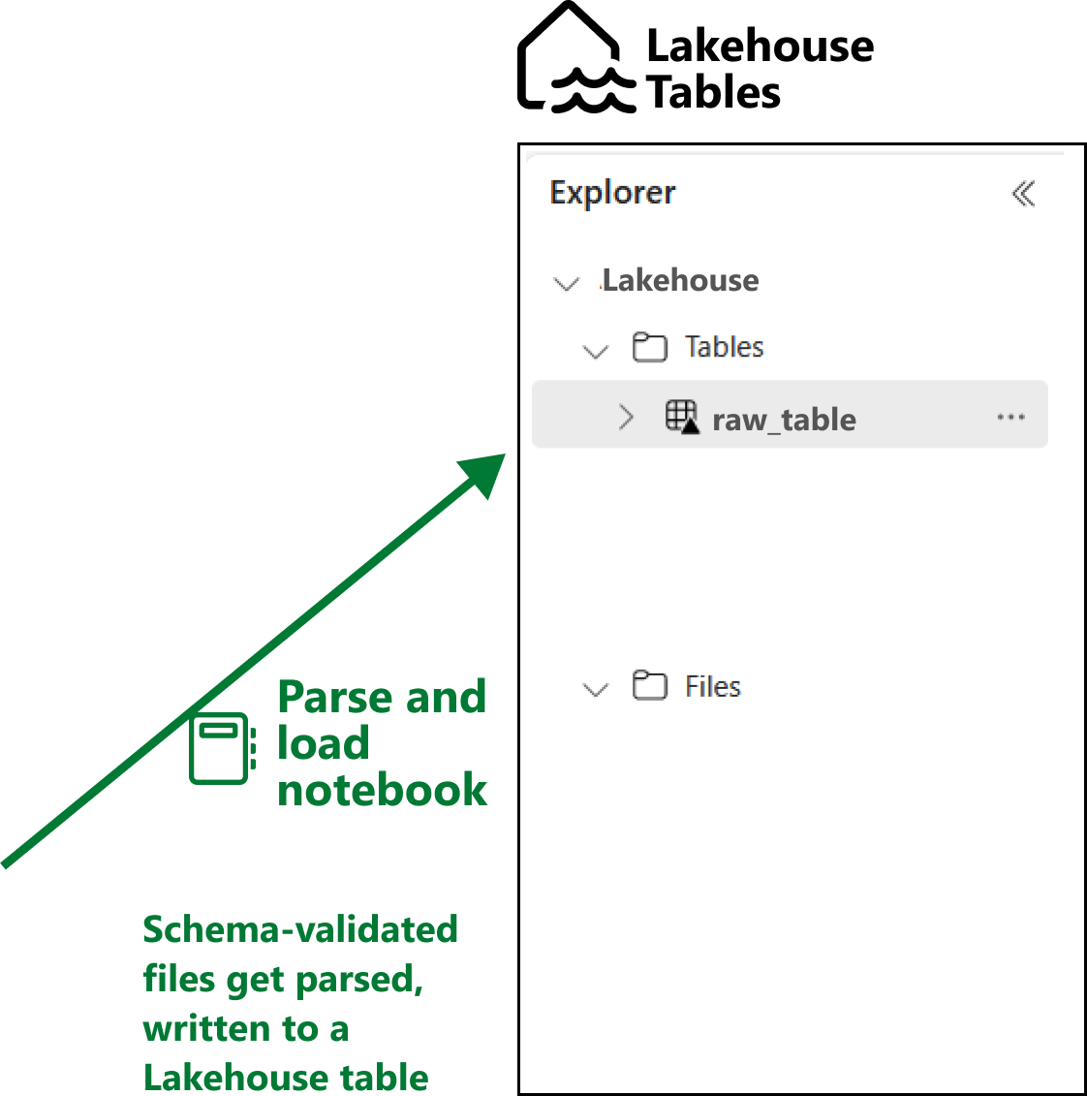

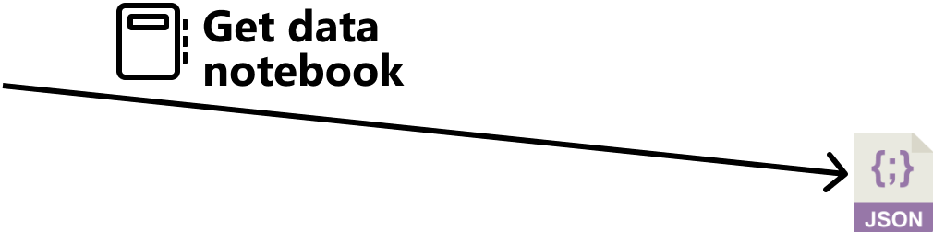
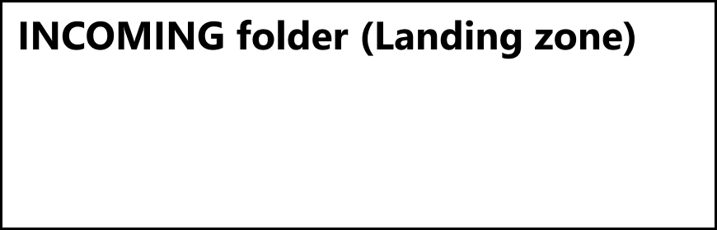

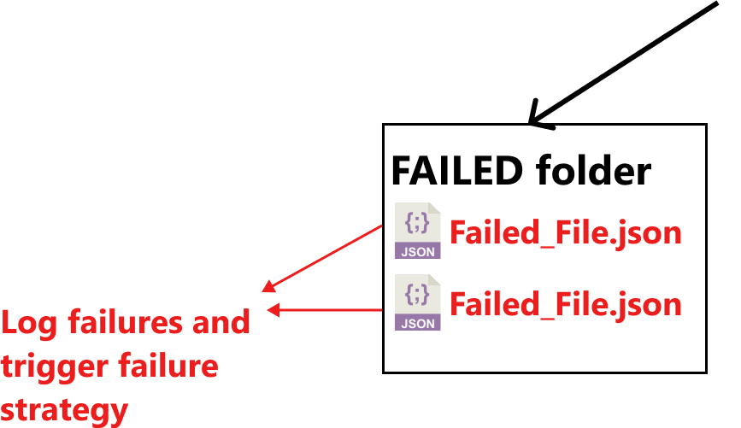
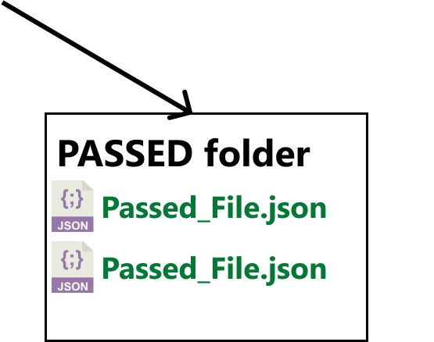
SCHEMA VALIDATION IN FABRIC
Notes:
All new data should pass into the landing zone for validation (no matter where they are coming from!)
The expected structure can be stored in a Schema Registry (this could be a Lakehouse table, or a folder in the Lakehouse Files area).
At this stage, the input and output is generally a file, so the structure of our Lakehouse files area could look like this:
Incoming (not-validated)
Validation – Passed
Validation – Failed
Schemas
If new data passes the schema validation it can be written into the Validation – Passed folder (and optionally, parsed and written to a Lakehouse table).
If the new data fails the schema validation, it is written to Validation –Failed folder

Slide 18
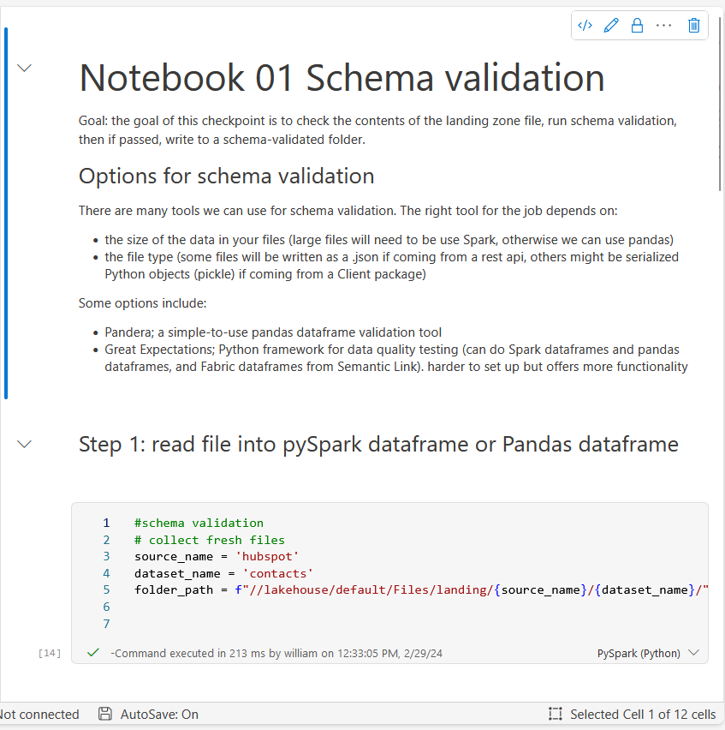



Inside the
What are we validating here?
Potential tooling
Example notebook
Data types
Data structure
Column names
Whether data is parsable

Slide 19
2
Table/ data frame validation
Core purpose:
Validation that structured data (tables/ dataframes) meet certain expectations in terms of data quality. This can vary depending on the dataset, and the stage in the pipeline.

Slide 20

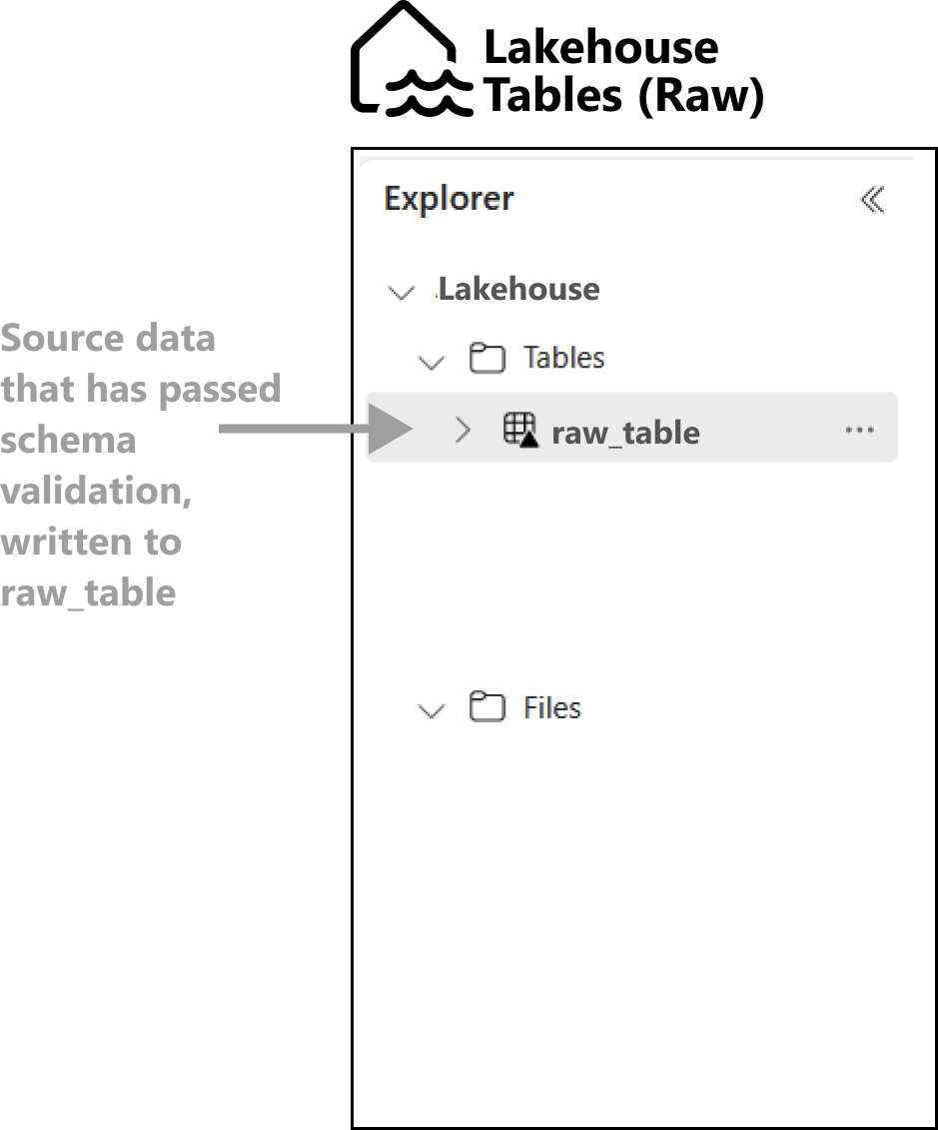
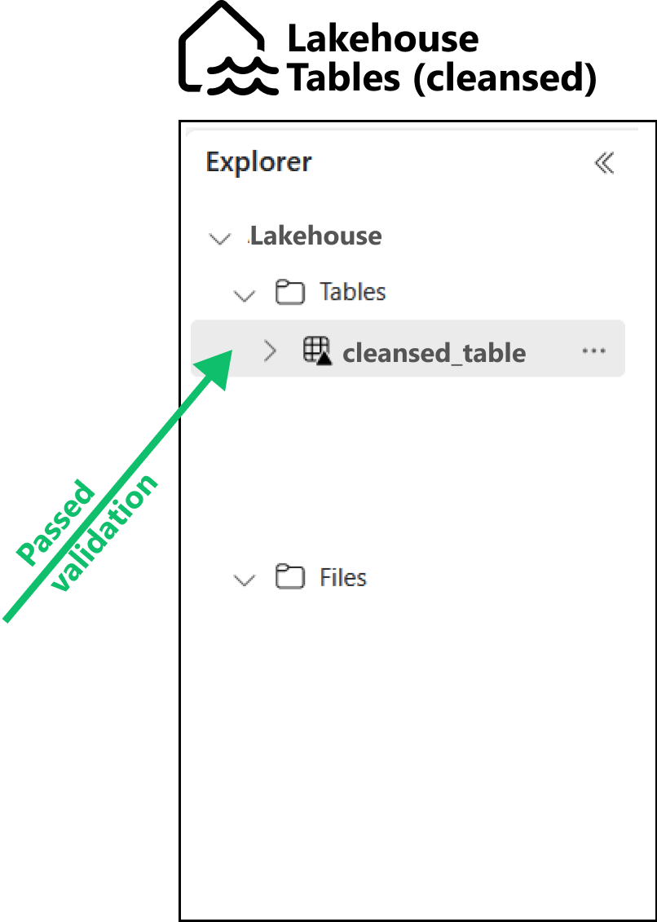
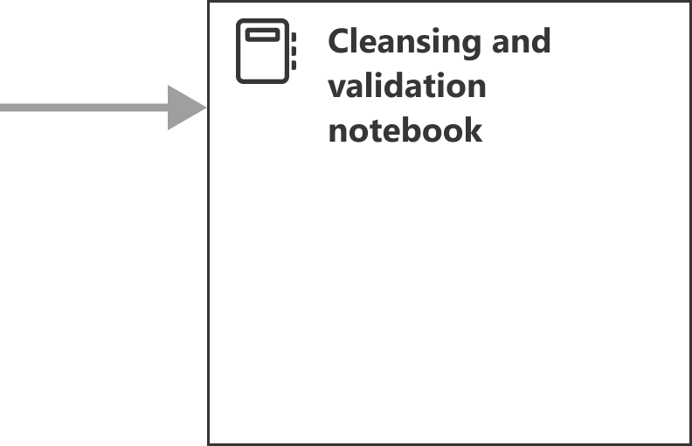
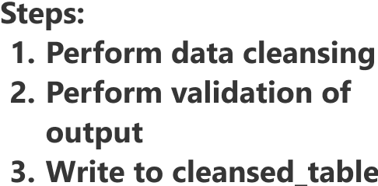
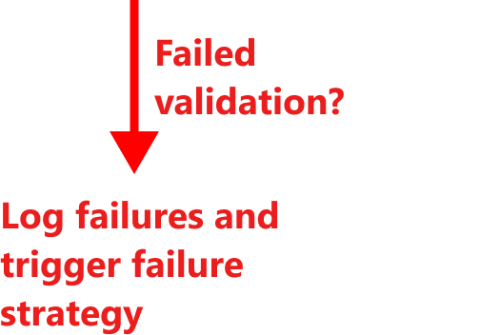
TABLE / DATAFRAME VALIDATION

Slide 21

Inside the
What are we validating here?
Potential tooling
Example notebook
It depends on your data, and your downstream analytics tasks. Typically:
Null values in ‘important’ columns
Values in expected range
Categoric variables in pre-defined list
Deduplication & primary keys are unique
Python (Spark):
Notebook 02: Table validation
SQL:

Slide 22

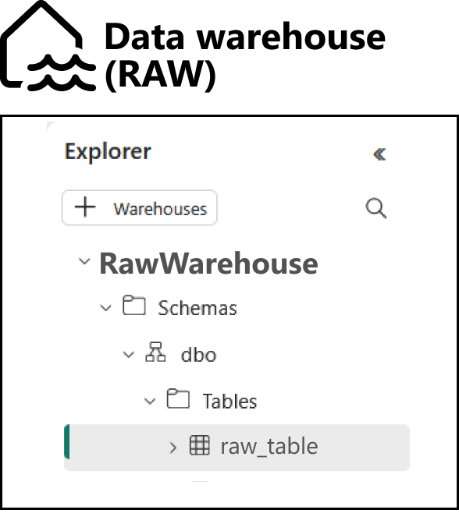
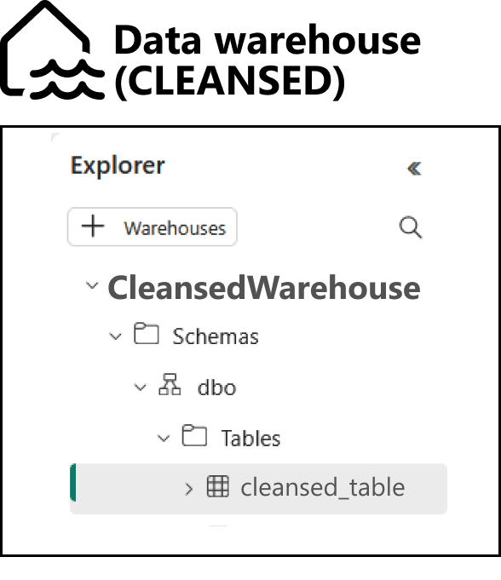
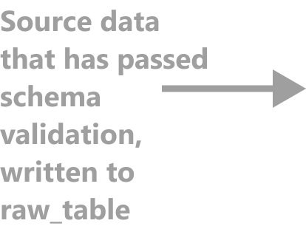
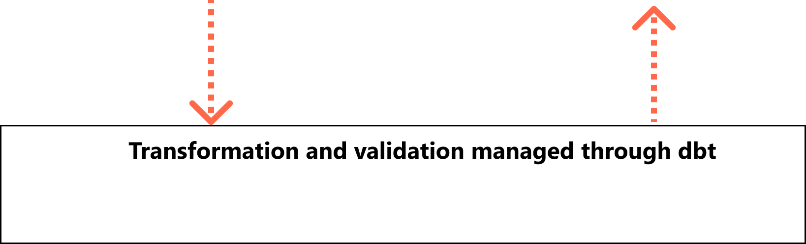

Using dbt for transformation & validation
Notes:
Important to note that you need to have a Data Warehouse architecture to use dbt, to allow you to materialize tables (write access, not possible using Lakehouse endpoint).
Enterprise-scale monitoring wit DBT is more difficult

Slide 23
3
Semantic model validation
Core purpose:
Validation that semantic information (relationships, calculations, DAX) has been correctly implemented in semantic model.

Slide 24
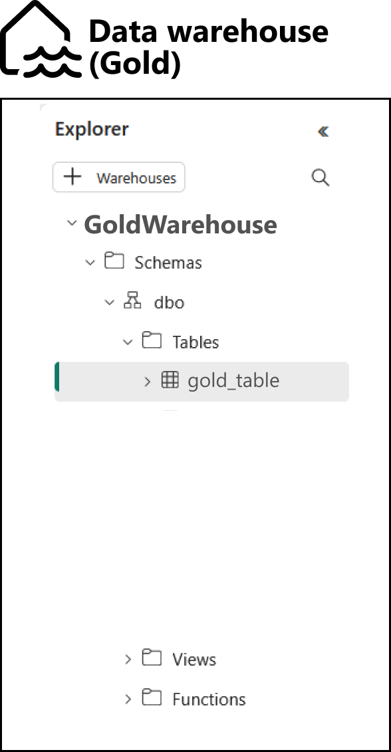
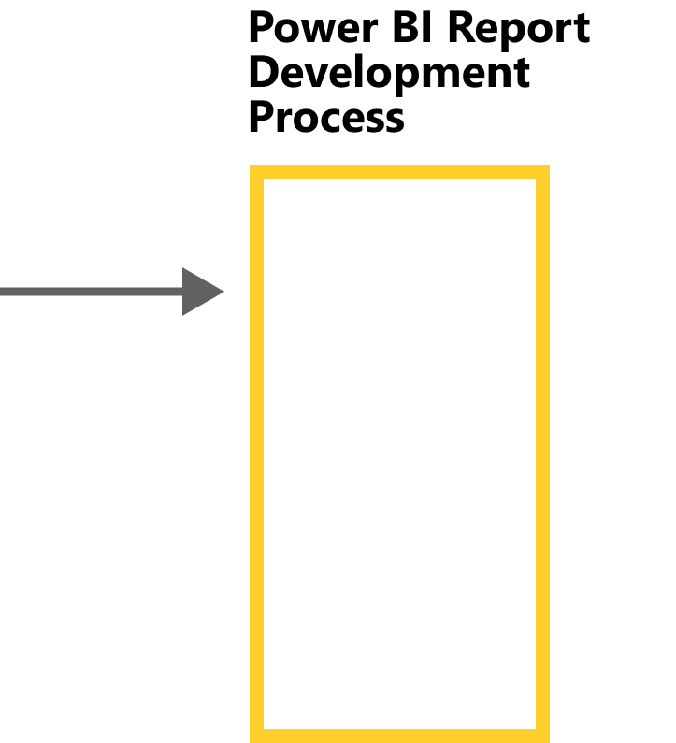
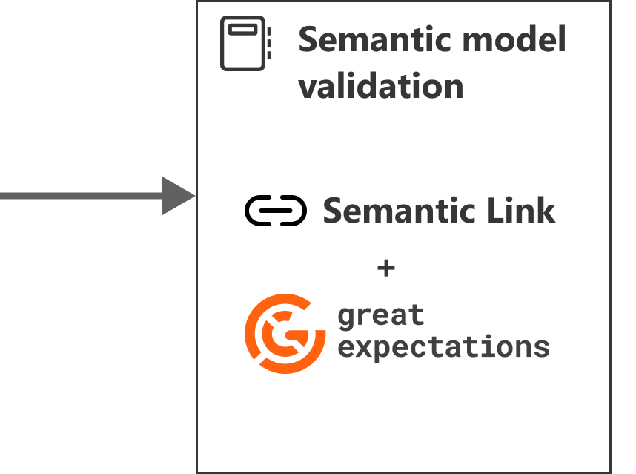
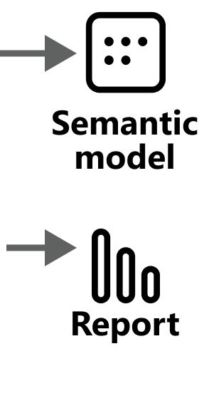
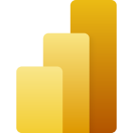
SEMANTIC MODEL VALIDATION

Slide 25

Inside the
What are we validating here?
Potential tooling
Example notebook
DAX measure return correct values
Semantic relationships correctly defined
Semantic Link
Notebook 03: Validating sematic models with GX

Slide 26
Wide review of tooling and approaches

Slide 27
Wide review of tooling and approaches
Approach/ tool | Language | Difficulty | Enterprise scale solution? | Cost | Notes
Code your own | Any Fabric language | High | No | Free
Pandera | Python | Low | No | Free | Requires custom validation result writing
Pydantic | Python | Low | No | Free | Requires custom validation result writing
Great Expectations | Python | High | Yes | Free (with optional paid service)
SQL stored proc | SQL | Medium | No | Free
DBT | SQL | Medium | Yes | Free (with optional paid service) | SQL tables only
DAX | DAX | Medium | No | Free

Slide 28
Wide review of tooling and approaches
Approach
/
Language
Difficulty
Enterprise
Cost
Notes
tool
scale
solution?
Code your
Any Fabric
High
No
Free
own
language
Requires custom validation result
Pandera
Python
Low
No
Free
writing
Pydantic
Python
Low
No
Free
Requires custom validation result
writing
Great
Free (with optional
Expectations
Python
High
Yes
paid service)
SQL stored
proc
SQL
Medium
No
Free
DBT
SQL
Medium
Yes
Free (with optional
SQL tables only
paid service)
DAX
DAX
Medium
No
Free

Slide 29
A strategy for enterprise scale monitoring of data quality
This represents one dataset flowing through your system…
In reality, you might have hundreds of pipelines like this.
So how do we manage and monitor all of these pipelines across your organisation?
Notes:
- I want to mention a slide about enterprise scale monitoring and reporting on data quality.
- If you want
- With Great Expectations, we receive validation results (as a file) after each validation run. We can treat this like a dataset and convert it into a Lakehouse table.
- All validation results are written into this table, and the table forms the basis for data quality reporting.

Slide 30
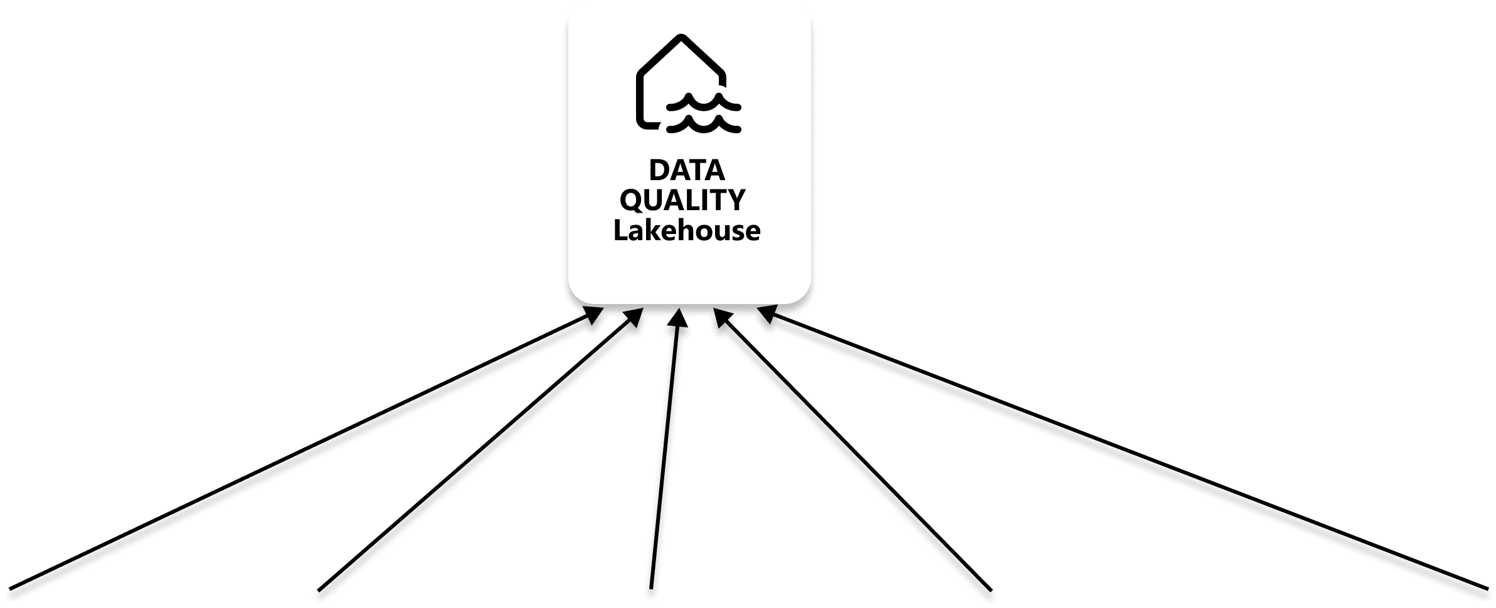
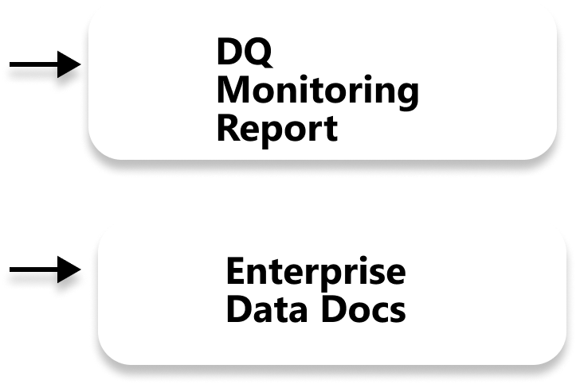
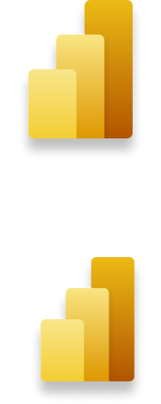
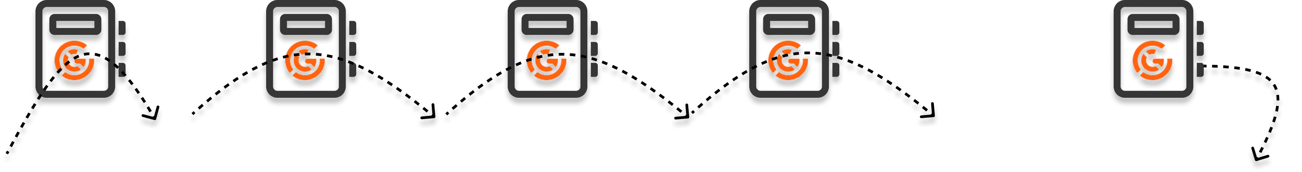
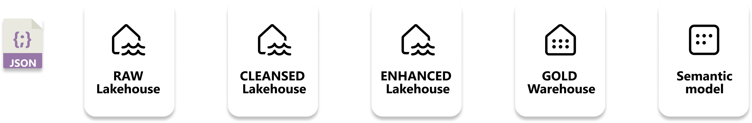
A strategy for enterprise scale monitoring of data quality
Validation results written to central Lakehouse
Notes:
- I want to mention a slide about enterprise scale monitoring and reporting on data quality.
- If you want
- With Great Expectations, we receive validation results (as a file) after each validation run. We can treat this like a dataset and convert it into a Lakehouse table.
- All validation results are written into this table, and the table forms the basis for data quality reporting.

Slide 31
A strategy for enterprise scale monitoring of data quality
-
Key points
It really helps if you only use one tool for data validation across your enterprise
I recommend Great Expectations as it can handle out-the-box all three types of data you might want to validate (source files, tables and semantic models)
A central logging lakehouse centralizes all validation results for all checkpoints for all pipelines. From this you can build a Data Quality monitoring Power BI report.
You can also make use of Great Expectations Data Docs functionality to document all datasets you are validating. The docs can be written to a Lakehouse, and a documentation Power BI can be presented back to your business.

Slide 32
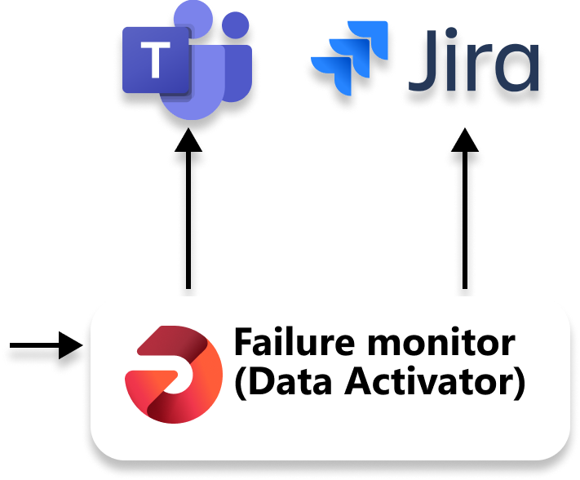
Failure monitoring
with Data Activator

Slide 33

Tying into Fabric data governance features
Certified warehouse
Certified semantic models
Notes:
Another feature we can tap into in fabric is item certification.
So we can tie in certification to a specific level of validation, such that a business user relying on this data knows the exact validation rules that have been passed for all data at this stage.
Can also tie into the Great Expectations data docs feature, so that your governance docs and are aligned to your GX data docs.

Slide 34
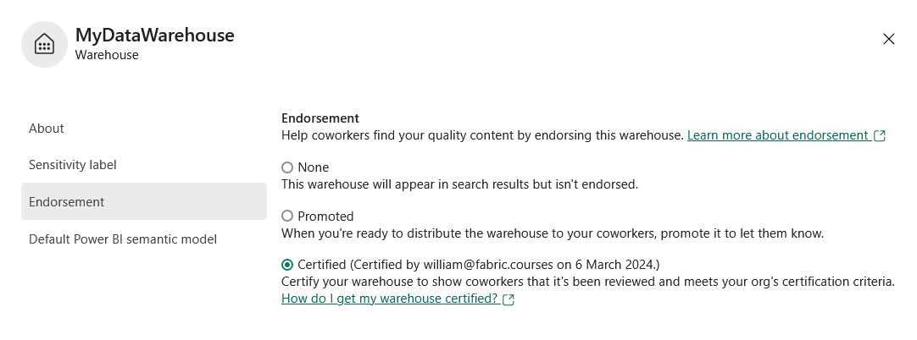
Tying into Fabric data governance features
Notes:
Another feature we can tap into in fabric is item certification.
So we can tie in certification to a specific level of validation, such that a business user relying on this data knows the exact validation rules that have been passed for all data at this stage.
Can also tie into the Great Expectations data docs feature, so that your governance docs and are aligned to your GX data docs.

Slide 35
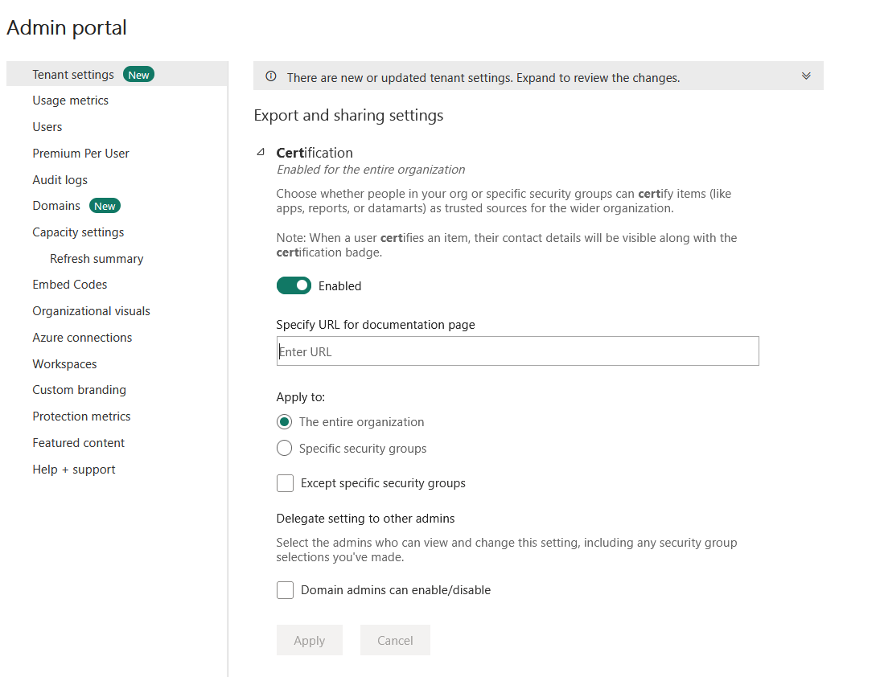

Tying into Fabric data governance features
Could point to Great Expectations Data Docs
Notes:
Another feature we can tap into in fabric is item certification.
So we can tie in certification to a specific level of validation, such that a business user relying on this data knows the exact validation rules that have been passed for all data at this stage.
Can also tie into the Great Expectations data docs feature, so that your governance docs and are aligned to your GX data docs.

Slide 36
Put data quality at the heart of your Fabric data strategy
Design the right architecture for data validation
Validate each stage in your pipeline
Choose the right tool
Setup enterprise-level monitoring
Design and implement a data quality failure strategy
Certify validated assets
Your next steps to embed data quality in your organisation
Notes:
Gain high-level acceptance that data quality assurance should form the foundation of your Fabric data strategy.
Design your data processing pipelines so that data is written out at regular intervals to allow for data validation and progressive assurance of data quality. there are many checkpoints or stepping stones in your pipelines
Think about how each step in your pipeline could fail (think edge cases!), and write validation tests to monitor when they fail
Choose the right tool for your use case and organisation
Setting up enterprise-level quality monitoring systems (tooling can help with this!)
Develop a strategy for dealing with validation failures (both within your data team and where necessary communicating effectively with ‘the business’).
Data quality can be tied Fabric data governance features (data documentation, certification)
Build automated data validation into your data engineering and business intelligence processes

Slide 37

Thanks for listening! Any questions?
Please leave feedback!
/in/willneedham
.com/microsoft-fabric
@LearnMicrosoftFabric

